Slide 1
Data Structures And Algorithms
Lecturer: Afshan Mehmood
afshan.mehmood@griffith.ie

Slide 2
Lecture 04- Fast Sorting
Bubble Sort
Selection Sort
Quick Sort
Merge Sort
Insertion Sort

Slide 3
Sorting
There are a number of ways of sorting a list of N numbers
Selection, Insertion and bubble are some of the easier ones
To start, we’re going to take a look at bubble Sort
Assume we have an array, A[], or elements to be sorted

Slide 4
Bubble Sort: Self Study
The simplest sort method
Each element compares itself to the next element
If its larger they swap places
This continues until all values have either swapped or stayed the same
The swap can either be from front to back or back to front

Slide 5
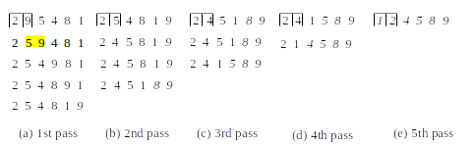
Bubble Sort

Slide 6
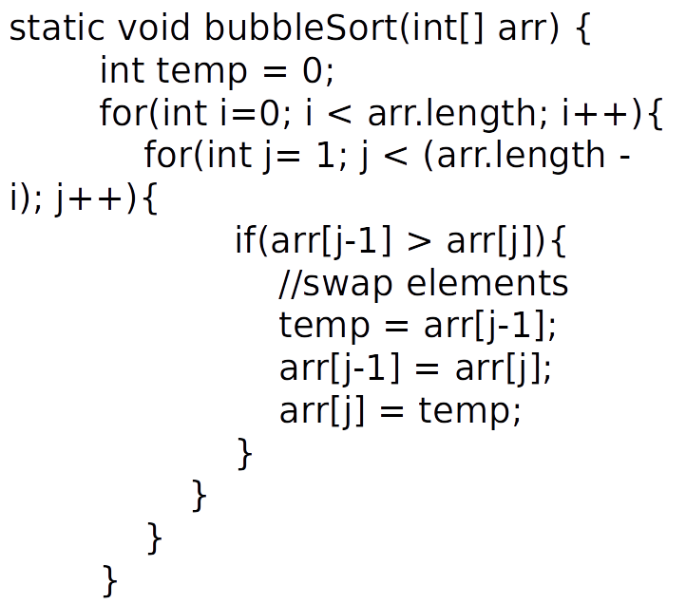
Bubble Sort

Slide 7
Bubble Sort
This implementation starts from the front, and moves the larger values towards the back
Each pass through the array places one item in its correct position
You always do n-1 passes through the array, even if it is already sorted
It is sometimes called sinking sort, or exchange sort

Slide 8
Bubble Sort
Bubbles ort can work from either the first item moving larger items towards the back of the list, or from the back moving smaller items towards the front
Performance can be improved by modifying it to a Bi-directional bubble sort
(that is, one pass from front to back, and the next from back to front)

Slide 9
Bubble Sort Time Complexity
Best Case O(n)
array is already sorted
No swaps needed, so only outer loop runs
Worst Case O(n^2)
array is in descending order, all items need to swap
array elements are required to be sorted in reverse order

Slide 10
Bubble Sort
Advantages
Very simple to implement
Adaptive , gets faster if a list is partially sorted
Disadvantages
Needs multiple iterations to swap all values
While simple to create it has poor time complexity and is a bad choice for large datasets

Slide 11
Selection Sort

Slide 12
Selection Sort
This sorting algorithm is an in-place comparison-based algorithm in which the list is divided into two parts, the sorted part at the left end and the unsorted part at the right end.
Initially, the sorted part is empty, and the unsorted part is the entire list.
Notes:
For example: array 0-5 a[6] 7,4,10,8,3,1, so draw array and show right hand side sorted and left unsorted.

Slide 13
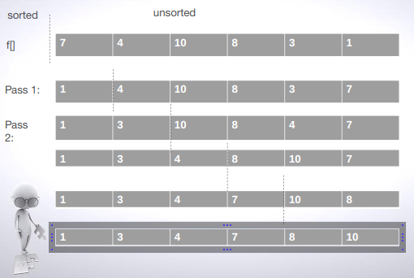
Selection Sort
Notes:
Number of passes a-1. where a is array size

Slide 14
Selection Sort
The smallest element is selected from the unsorted array and swapped with the leftmost element, and that element becomes a part of the sorted array.
This process continues moving unsorted array boundary by one element to the right.
Notes:
array 0-5 a[6] 7,4,10,8,3,1. min=1 so it will come 1,3,4,8,7,10

Slide 15
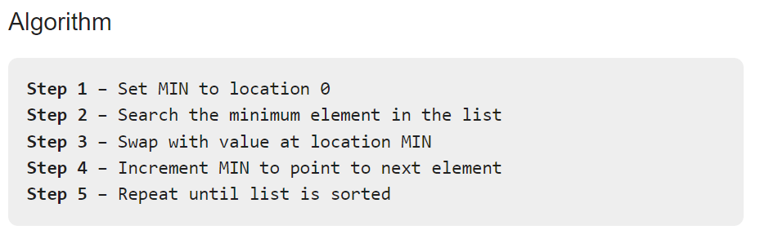
Selection Sort
Consider the following depicted array as an example.
A[]={14,33,27,10,35,19,42,44}
Notes:
Answer: 10,14,19,27,33,35,42,44

Slide 16
Selection Sort
static void selectionSort(int arr[]) {
for(int i = 0; i < arr.length; i++){
//find smallest
int smallest = i;
for(int j = i + 1; j < arr.length; j++){
if(arr[j] < arr[smallest])
smallest = j;
}
// swap
int temp = arr[i];
arr[i] = arr[smallest];
arr[smallest] = temp;
}
}
Notes:
First loop is for passes.
Second loop for finding minimum element
K is minimum here
You can use swap function as well

Slide 17
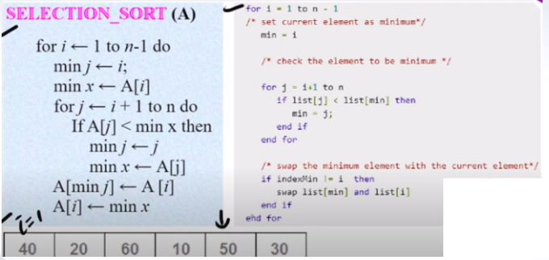
Selection Sort

Slide 18
Selection Sort
static void selectionSort(int list[]) {
for(int i = 1; i < n; i++){
//find min
int min = i;
for(int j = i + 1; j <=n; j++){
if(list[j] < list[min])
min = j;
}
// swap
int temp = list[i];
list[i] = list[min];
list[min] = temp;
}
}

Slide 19
Selection Sort
Time complexity: O(N^2) because it involves a loop within a loop over a space of size f.length.
Formally, Worst- and best-case performances are both of O(N^2)
Best case: array is already sorted
Worst case: array is in reverse order, all items need to swap

Slide 20
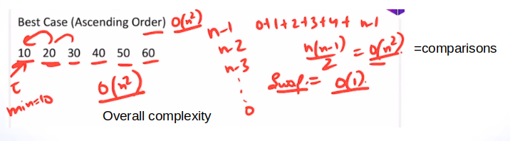
Selection Sort

Slide 21
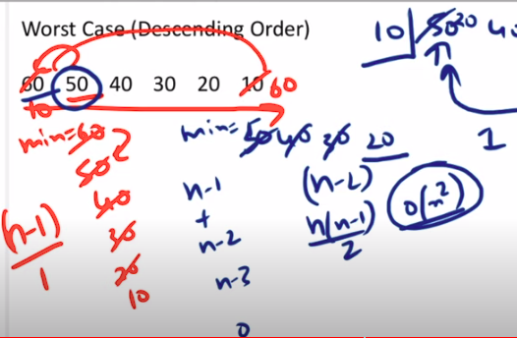
Selection Sort

Slide 22
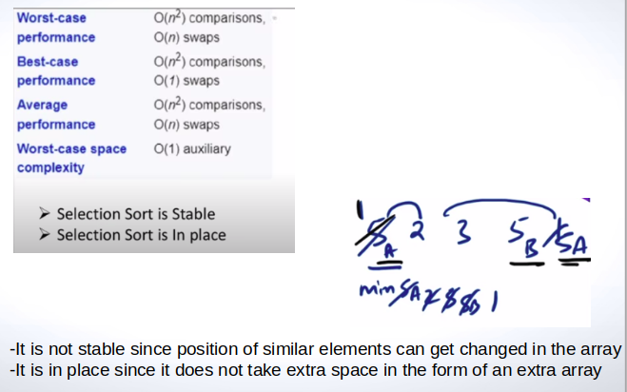
Selection Sort

Slide 23
Selection Sort
Advantages
Good when we need to check all elements
works similarly on all kinds of dataset
Disadvantages
we must loop through every unsorted element each time
the double loop structure can be inefficient for large data sets
the algorithm has no way of recognizing when the dataset is sorted

Slide 24
Fast Sorting Algorithms
Here we look at two comparison-based algorithms that provide O(n*log₂n) solutions
Quicksort - Tony Hoare 1960
Merge Sort - John von Neumann 1945

Slide 25
Quick Sort

Slide 26
Quick Sort- Divide and Conquer
Given an array of n elements (e.g., integers):
If array only contains one element, return
Else
-Pick one element to use as pivot.
-Partition elements into two sub-arrays:
Elements less than or equal to pivot
Elements greater than pivot
-Quicksort two sub-arrays
-Return results
Notes:
By default, ascending order
Pivot element (that can be anything)
Divide and Conquer.
Partitioning.

Slide 27
Quick Sort
There are number of ways to pick the pivot element.
Given a pivot, partition the elements of the array such that the resulting array consists of:
Elements > pivot on the right side of array.
And elements <= pivot on the left side of array.
Swap the pivot with element at the partition index.
Notes:
The strategy adopted in quicksort is to shuffle the elements in the array into two non-empty partitions/sections so that all the elements in the left partition are less than or equal to those in the right partition. The elements in each partition are not necessarily sorted

Slide 28
Quick Sort
Pivot: Random, Median, First, Last
Lower bound and upper bound
Partition : Left side element less than pivot; right side element greater than pivot.
Partition
Pivot
Partition

Slide 29
Quick Sort
The strategy adopted in quicksort is to shuffle the elements in the array into two non-empty partitions/sections so that all the elements in the left partition are less than or equal to those in the right partition
The elements in each partition are not necessarily sorted

Slide 30
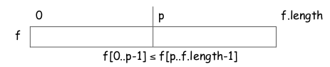
Quick Sort
The following diagram describes this situation.
It now only remains to quickSort f[0..p-1] and then quickSort f[p..f.length-1], and the whole array is sorted
( i.e. we repeat the steps on f[0..p-1] and f[p..f.length-1] and then continue repeating this process until the array is sorted)

Slide 31
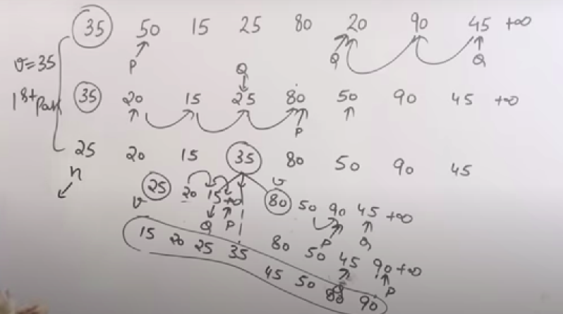
Quick Sort

Slide 32
35 50 15 25 80 20 90 45 infinity
Pivot=35
35 50 15 25 80 20 90 45 inf
P Q
Increment P till get a value greater than Pivot
Decrement Q till get a value lesser than Pivot
35 20 15 25 80 50 90 45 inf
P Q
P 80, Q 25
When Q crosses P, stop
Swap Pivot with value of Q
25 20 15 35 80 50 90 45
25 20 15 inf 35 80 50 90 45 inf
Q P
Pivot=25
P=20
Q=15
When Q crosses P, stop
Swap Pivot with value of Q
15 20 25 35 80 50 90 45 inf
Solve 80 50 90 45 inf
Pivot =80, P=50, Q=45
Increment P till get value greater than Pivot
Decrement Q till get value lesser than Pivot
New P=90, Q=45
Swap so array becomes 80 50 45 90
Increment P till get value greater than Pivot , P stops at infinity, Q stops at 50, SInce Q crossed P, swap Pivot with value of Q
New array 45 50 80 90

Slide 33
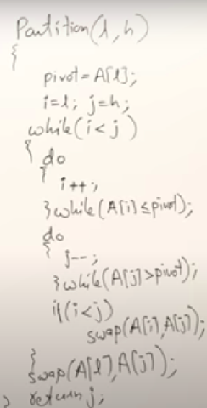
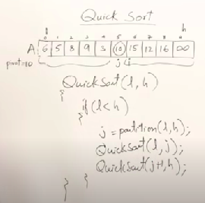
Quick Sort

Slide 34
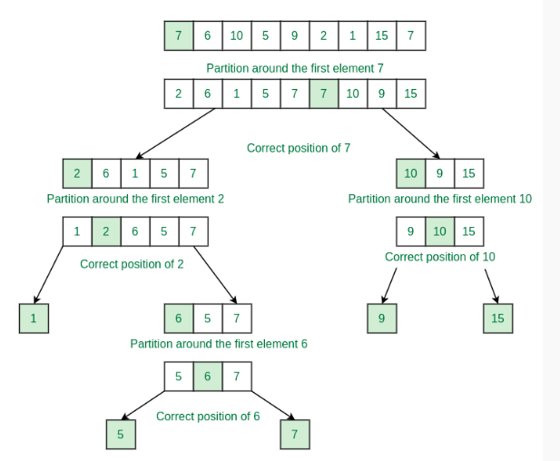
Quick Sort

Slide 35
Quick Sort
Follow the below steps to implement the approach.
Use a recursive function (say quickSort) to initialize the function.
Call the partition function to partition the array and inside the partition function do the following
Take the first element as pivot and initialize and iterator k = high.
Iterate in a for loop from i = high to low+1:
If arr[i] is greater than pivot then swap arr[i] and arr[k] and decrement k.
After the iteration is swap the pivot with arr[k].
Return k-1 as the point of partition.
Now recursively call quickSort for the left half and right half of the partition index.

Slide 36
Quick Sort Algorithm
// let’s say f is an array we want to sort
int[] f = {9, 2, 4, 5, 7, 8, 3, 6};
static void quickSort(int[] f, int start, int end){
if(start < end){
int partitionIndex = partition(f, start, end);
quickSort(f, start, partitionIndex-1);
quickSort(f, partitionIndex+1, end);
}
}

Slide 37
Quick Sort Algorithm
static int partition(int[] f, int start, int end){
int pivot = f[end];
int partitionIndex = start;
// loop through all the values
for(int i=start; i<end; i++){
if(f[i] <= pivot){
// swap if element is less than pivot
swap(f[i], f[partitionIndex]);
partitionIndex++;
}
}
// finally swap pivot with element at the partition index
swap(f[partitionIndex], f[end]);
return partitionIndex;
}

Slide 38
Analysis: Time complexity
Best performance: O(N*logN) i.e. the pivot divides the array into two parts of about the same size.
Worst case: O(N²) i.e. the pivot divides the array into one big subarray with the other empty.
Choice of element to partition around is the main cause of variation
First element
Middle element
Average of first, last and middle

Slide 39
Analysis: Time complexity
Best Case O(n log n)
pivot element is the middle element
Average Case O(n log n)
array is jumbled
Worst Case O(n2)
pivot element is the smallest or largest element
Notes:
The running time of quicksort depends on whether the partitioning is balanced or unbalanced
This depends on which elements are used for partitioning
If the partitioning is balanced, the algorithms runs pretty fast O(n log n)
If it is unbalanced, it can run asymptotically as slow as insertion sort

Slide 40
Quick Sort Dual Pivot
There is also a more advanced version of the quick sort , the dual pivot Quicksort
It take two pivots, the left end of the array and the right end of the array.
It is typically faster than a one pivot version.
In Java the Array.sort method uses a Dual-Pivot Quicksort algorithm

Slide 41
Merge Sort

Slide 42
Merge Sort
Divide the sequence using (lb+ub)/2
Divide your sub-sequence until you get 1 element.
Then, merge sub-sequence until the complete sequence is sorted.

Slide 43
Merge Sort
The merge sort closely follows the divide and conquer paradigm
Recursively divide a given sequence of values until the size of the sequence to be sorted is 1
Merge the sequences
The division involves no comparisons.
Then merge sorted sub-sequences to form sorted sequence

Slide 44
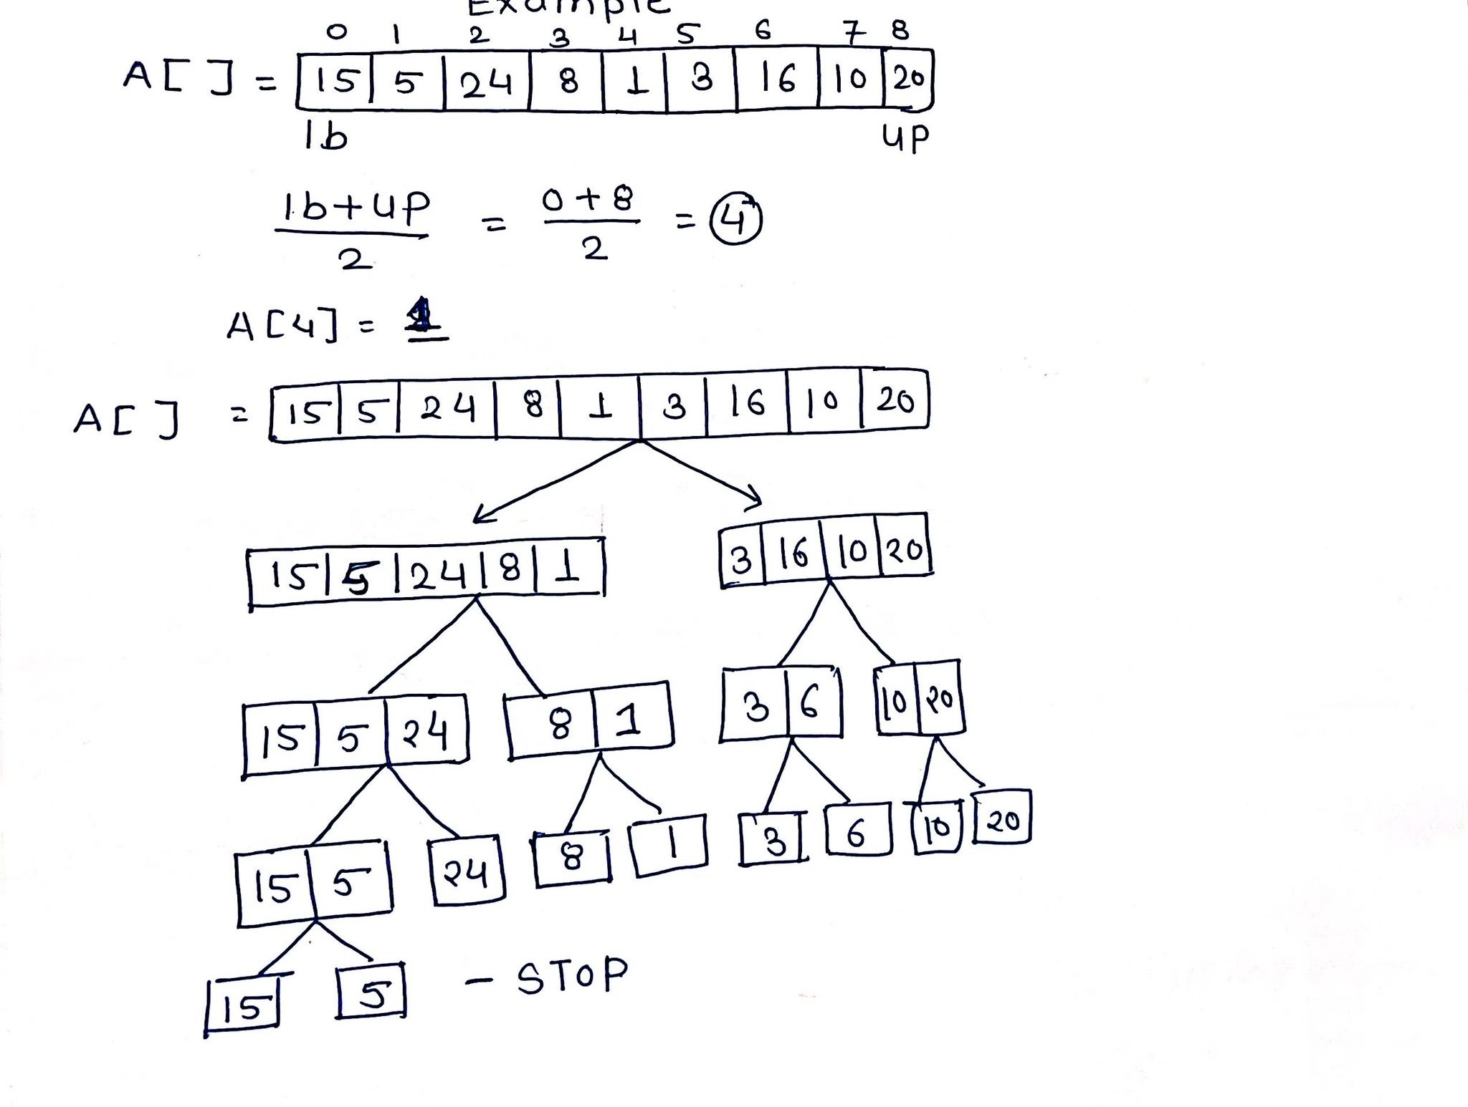
Example

Slide 45
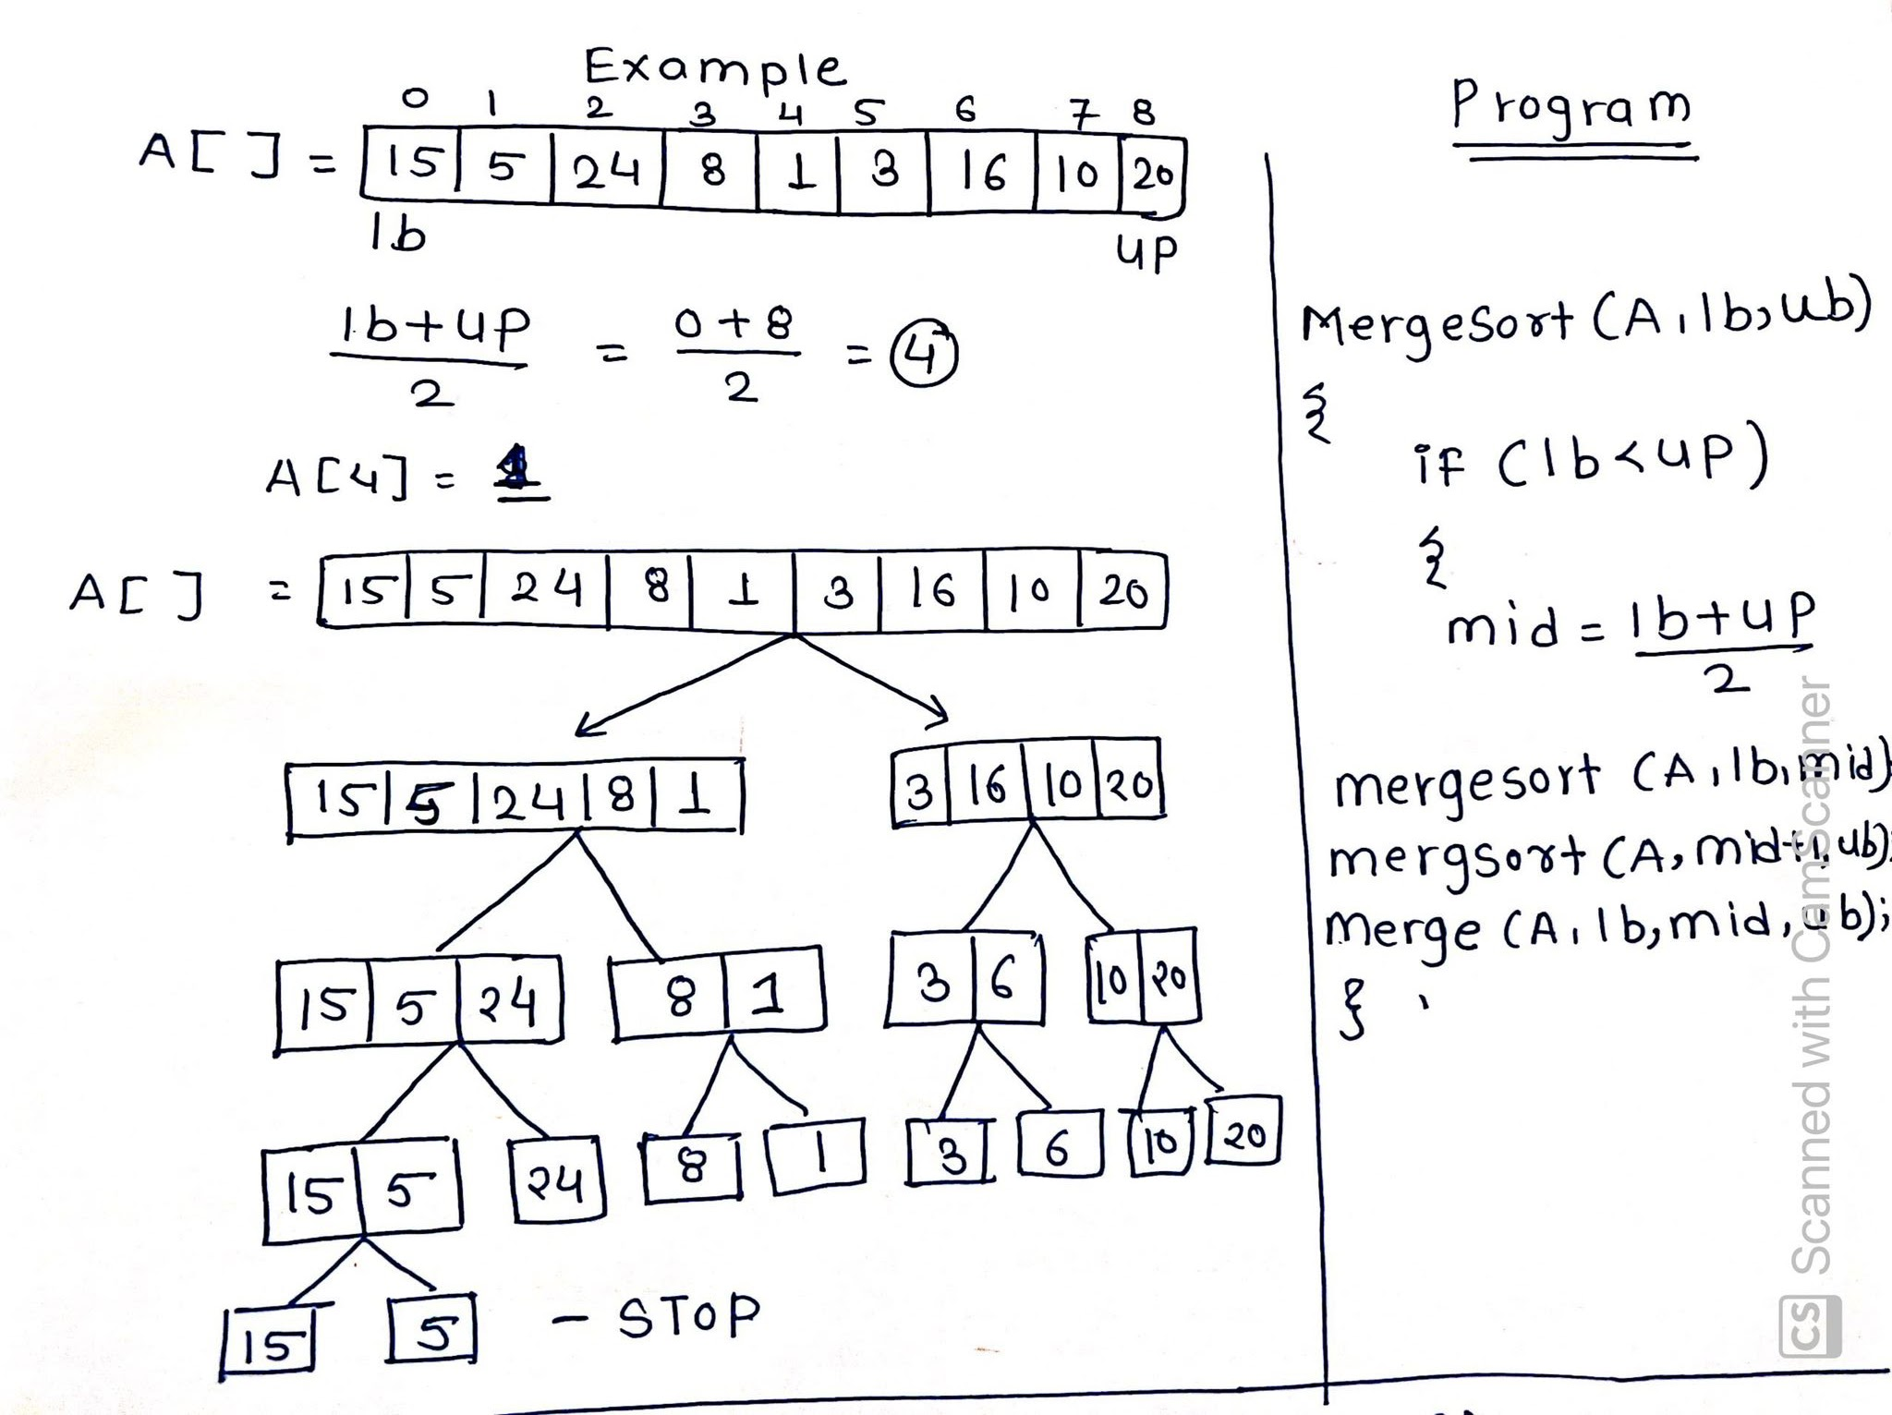

Slide 46
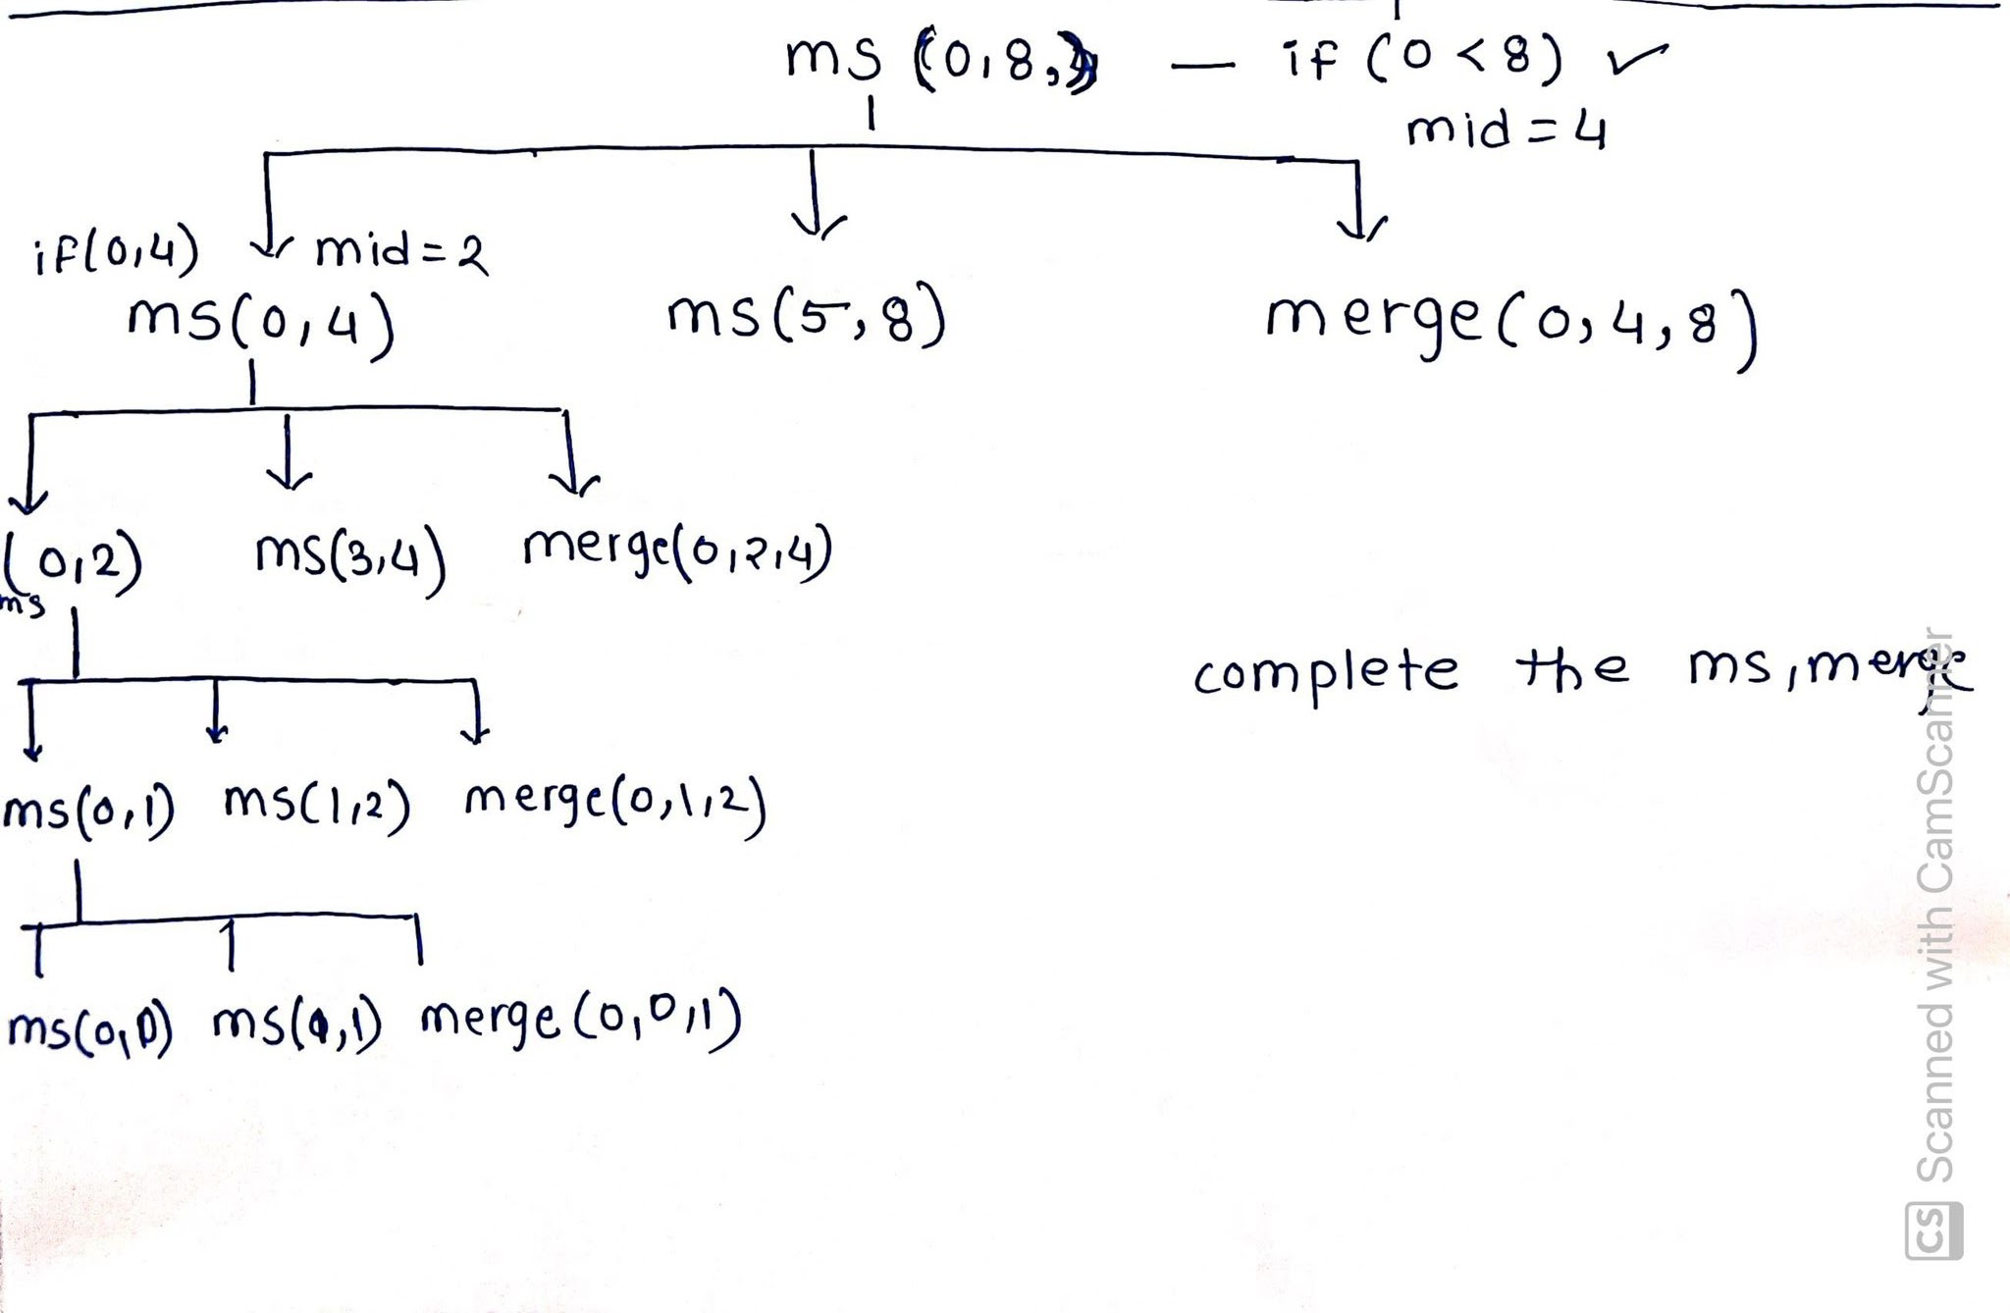

Slide 47
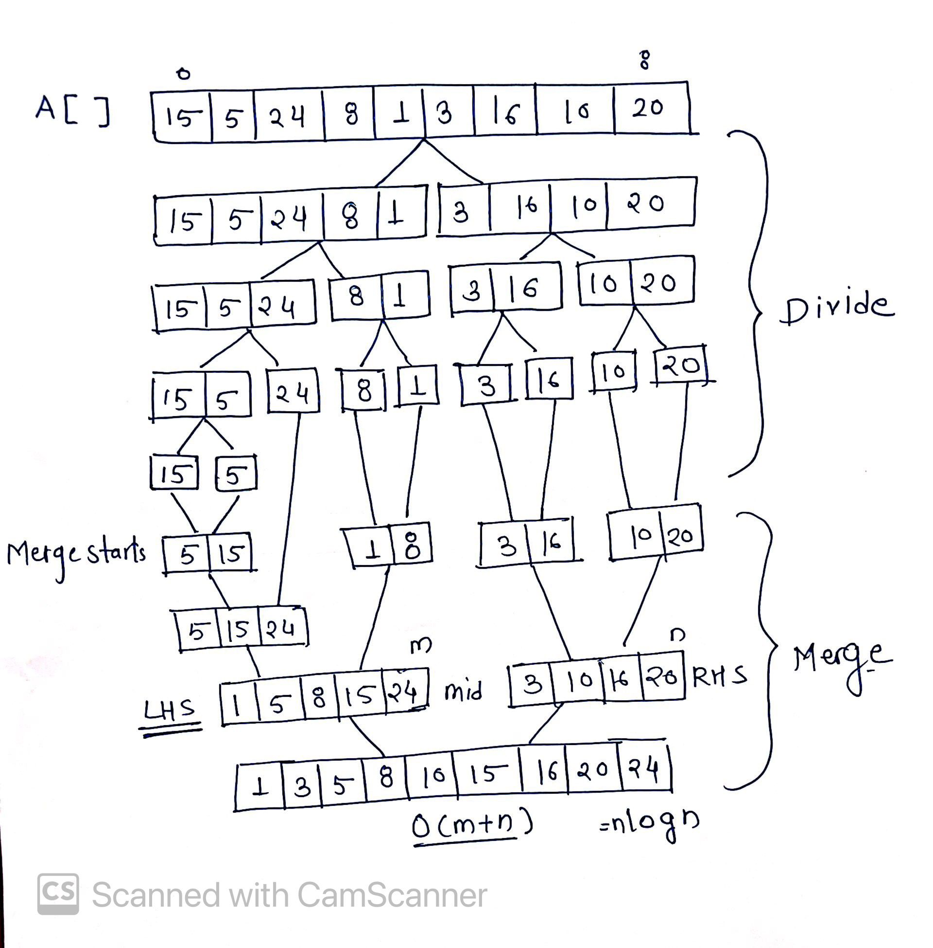

Slide 48
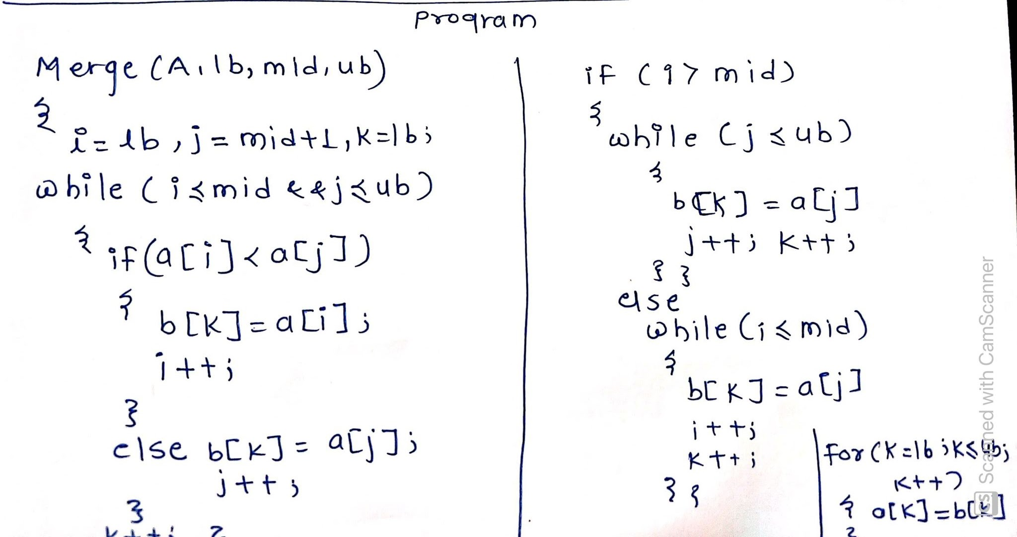

Slide 49
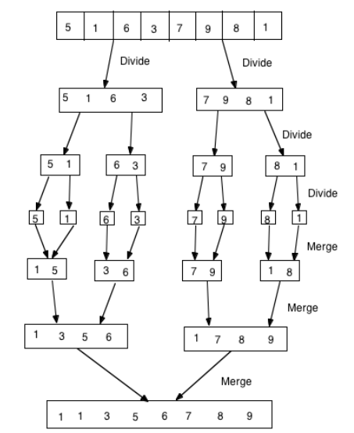
Notes:
An axiom is a premise or starting point of reasoning. A self-evident principle or one that is accepted as true without proof as the basis for argument
Peano Axiom are a set of axioms for the natural numbers

Slide 50
Merge sort algorithm
static void mergeSort(int f[], int lowerB, int upperB){
if(lowerB + 1 < upperB){
int mid = (lowerB + upperB)/2;
mergeSort(f, lowerB, mid);
mergeSort(f, mid, upperB);
merge(f, lowerB, mid, upperB);
}
}

Slide 51
static void merge(int f[], int lowerB, int mid, int upperB){
int i = lowerB;
int j = mid;
//use temp array to store merged sub-sequence
int temp[] = new int[upperB - lowerB];
int t = 0;
while(i < mid && j < upperB){
if(f[i] <= f[j]){
temp[t] = f[i]; i++; t++;
}
else{
temp[t] = f[j]; j++; t++;
}
}

Slide 52
//tag on remaining sequence
while(i < mid){
temp[t] = f[i]; i++; t++;
}
while(j < upperB){
temp[t] = f[j]; j++; t++;
}
//copy temp back to f
i = lowerB;
t = 0;
while(t < temp.length){
f[i] = temp[t];
i++; t++;
}
}

Slide 53
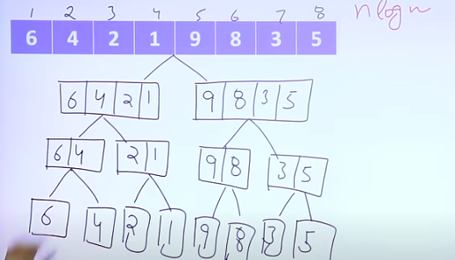
Example

Slide 54
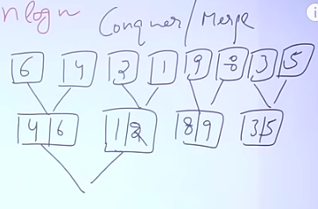

Slide 55
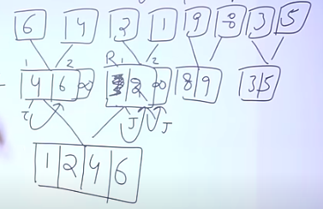

Slide 56
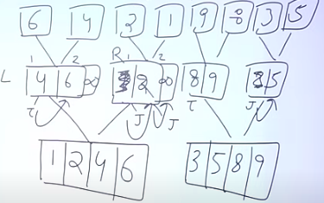

Slide 57
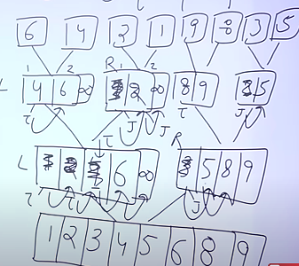

Slide 58
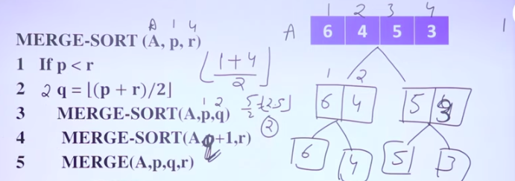

Slide 59
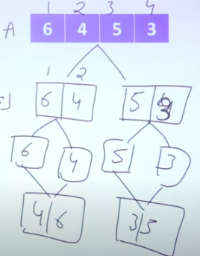

Slide 60
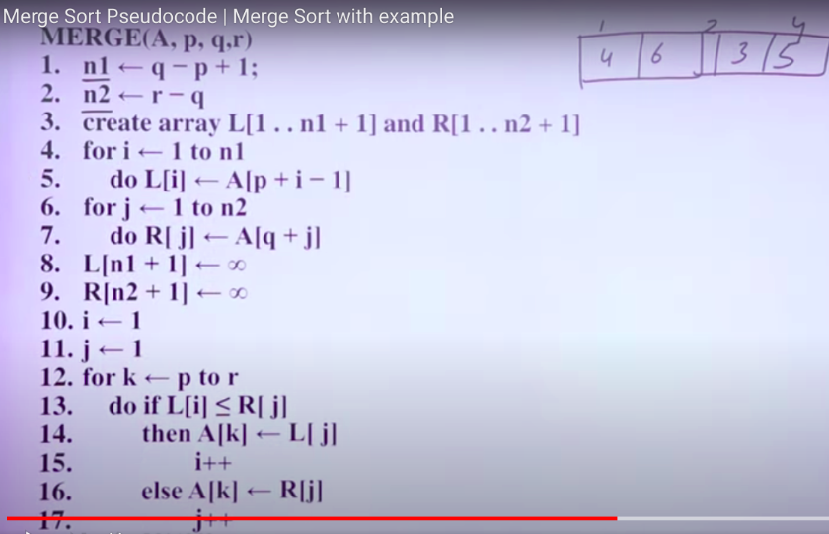
Notes:
Java provides the package java.io that has a number of classes and associated methods that can be used in programs to access the file system on your disk, create new files, read information stored on file and process it, write new information to a file, etc.
The File class contained in this package provides the required methods to solve this problem

Slide 61
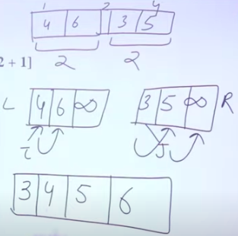

Slide 62
Analysis
Time complexity: Always O(N*logN) because merge is O(N) and division is O(logN)
Overhead of creating temp array and copying data to original array
For large data sets QuickSort outperforms it
Stable

Slide 63
Insertion Sort

Slide 64
Insertion Sort
Divide array into two part sorted and unsorted array.
Sorted consist of first element of an array a[0]
Unsorted array start from a[1]
Compare a[1] with sorted array and put in correct position.
Put according to ascending order in LHS
Order is O(n*n)
Stable

Slide 65
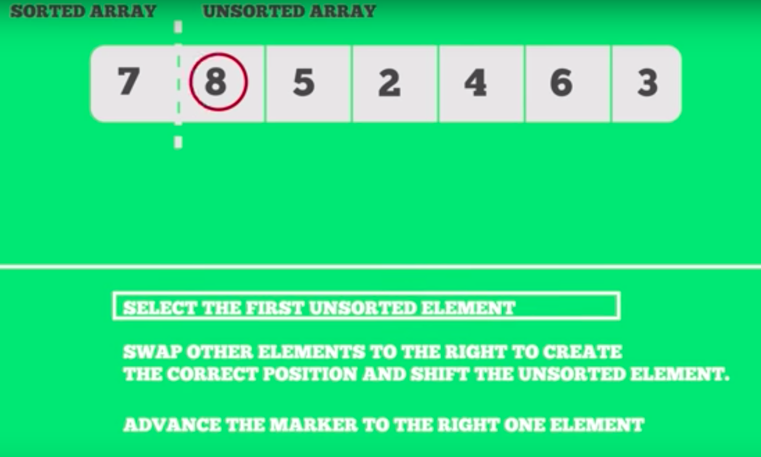

Slide 66
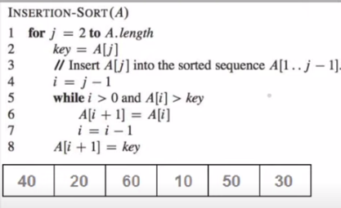

Slide 67
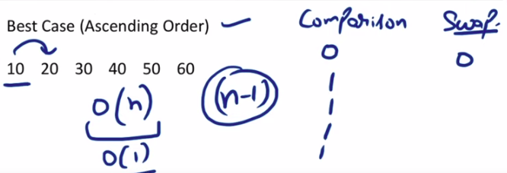

Slide 68
Time complexity
Time complexity
Best case : O(n)
Worst case: O(n*n)
Best case : O(n)
Worst case: O(n*n)

Slide 69
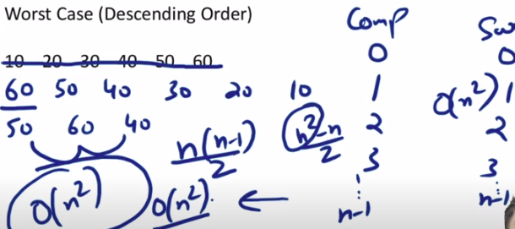

Slide 70
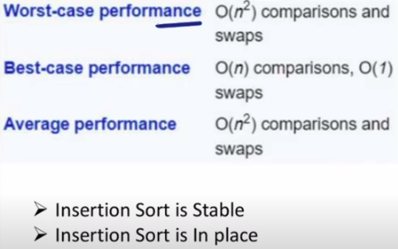
-If relative ordering of similar elements does not change, it is stable.
-It does not use extra space or temporary array (of similar size as in merge sort algorithm) so it is in place.
-Also called online algorithm.

Slide 71
Think!
To illustrate this, we calculate fac(5) as follows:
fac(5) => getFac(1,1,5) => getFac(2,2,5) => getFac(6,3,5) => getFac(24,4,5) => getFac(120,5,5) => 120
Notice that the stack is not used to store the result term by term as before. Instead, each invocation of getFac completes and the result is accumulated in parameter a. Hence, when it terminates the result is just the value of a.

Slide 72
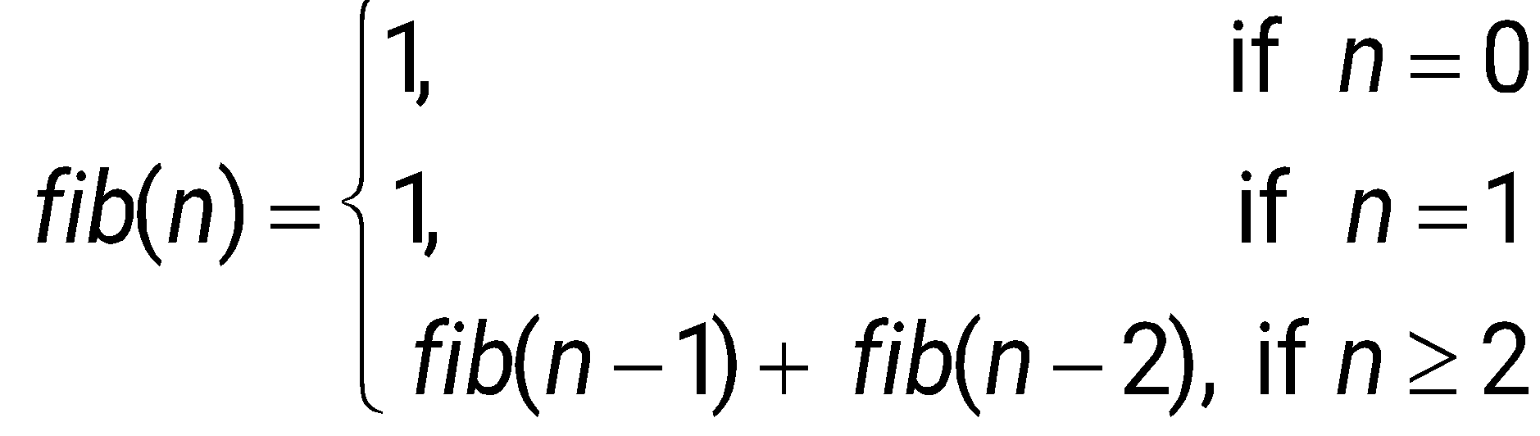
Practice question
Write a function to compute fib(n), a term in the Fibonacci sequence, that is defined recursively as:
Sol:
public int fib(int n) {
if (n <= 1) {
return 1; }
else {
return fib(n-1) + fib(n-2);
}
}

Slide 73
Practice question
Write a recursive function that computes the sum of the terms in an integer array.
Answer
public int sum(int[] f, int i) {
if (i == f.length)
return 0;
else {
return f[i] + sum(f,i+1);
}
}

Slide 74
Practice question
Given below is a recursive function called fac that calculates n! Use this function to calculate fac(5).
static int fac(int n){
if(n == 0) return 1;
else return n * fac(n-1);
}
Answer
Fac(5) = 5*fac(4) = 5*4*fac(4)=5*4*2*fac(2) = … = 120

Slide 75
Self Study

Slide 76
Binary Search
Any problem that can be solved recursively can also be solved iteratively (using a loop)
Let us look at Binary Search both recursively & Iteratively

Slide 77
Iterative Solution
Given a sorted array of integers and some integer x, write code to determine if x is an element of the array
The strategy is to repeatedly start with the middle element and continuously halve the size of the search space until it reaches a segment of size 1. The value in this segment is the outcome of the search.

Slide 78
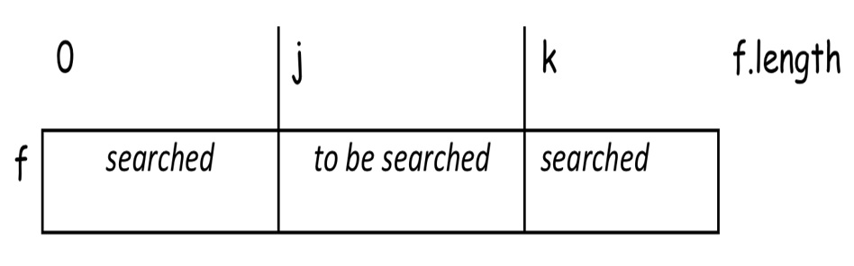
Iterative Solution
An invariant diagram to describe this strategy is:

Slide 79
Iterative Solution
This solution describes the binary search in terms of a loop construct. A static function that defines its implementation is given below.
static boolean binSearch(int f[],int x){
int j = 0;
int k = f.length;
while(j + 1 != k){
int i = (j + k)/2;
if( x >= f[i])
j = i;
else
k = i;
}
return(f[j]==x);
}

Slide 80
Binary Searching
This is an iterative solution that uses a while loop to control the search.
We can also write a recursive solution by passing the lower and upper bounds to the search function as arguments.
Like the iterative solution above, the recursion terminates when a segment of size 1 is isolated. For all segments of size larger than 1 the middle term is compared with x and the appropriate new segment is searched.

Slide 81
Recursive Binary Search
boolean binarySearch(int f[], int lb, int ub, int x){
if(lb+1 == ub) return (f[lb] == x);
else{
int mid = (lb+ub)/2;
if(x >= f[mid])
return binarySearch(f,mid,ub,x);
else
return binarySearch(f,lb,mid,x);
}
}

